Slide 1




CSC3170 Tutorial 2
Qi, Xixian (120090691)
2024/01/23

Slide 2

Relational Schema
1
Keys
2
Relational Algebra
3

Slide 3
Relational Schema

Slide 4
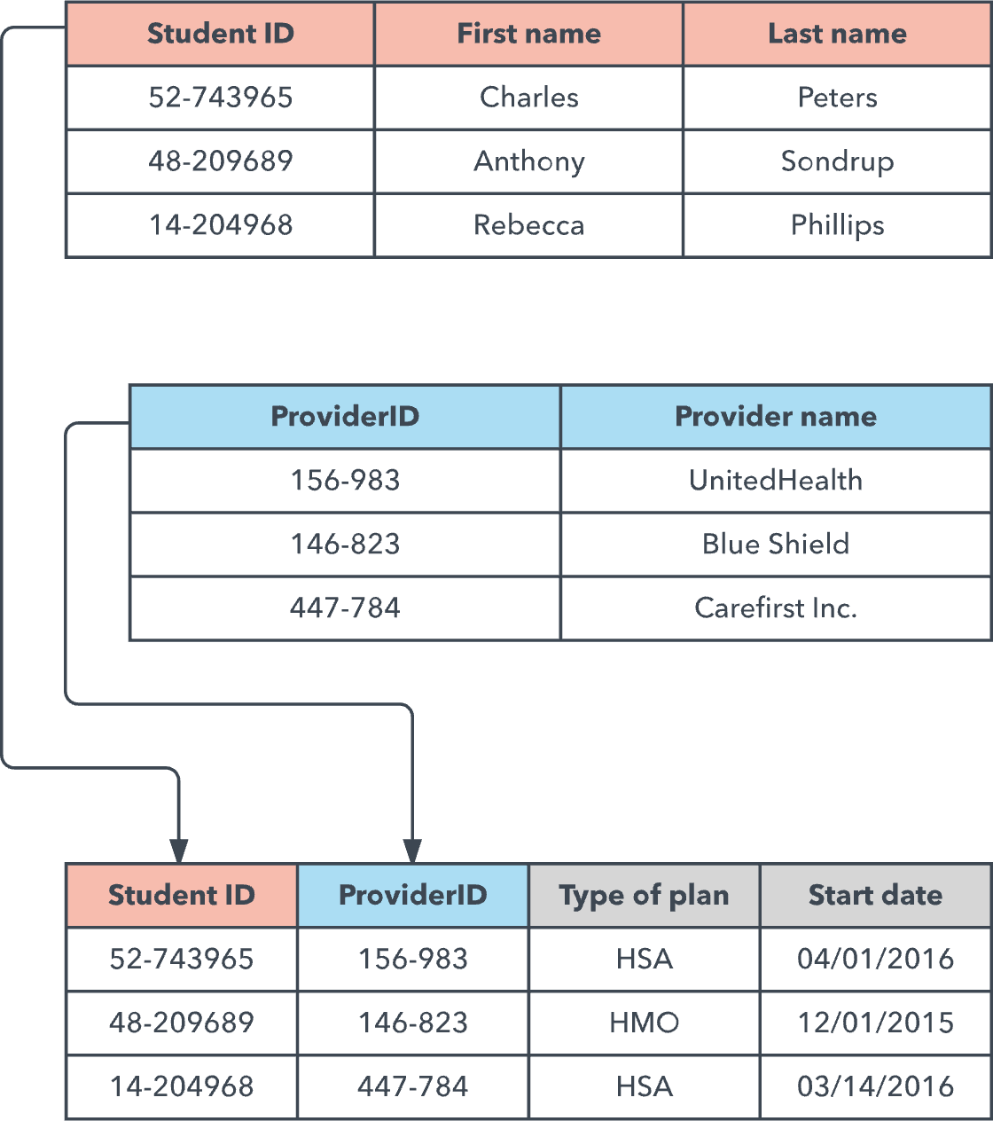
01
Database model
A database model shows the logical structure of a database, including the relationships and constraints that determine how data can be stored and accessed. There are many kinds of data models, including:
Hierarchical database model
Relational model
Network model
Object-oriented model
Entity-relationship model
Document model
Entity-attribute-value model
Star schema
Object-relational model
Fig: Example of relational model

Slide 5
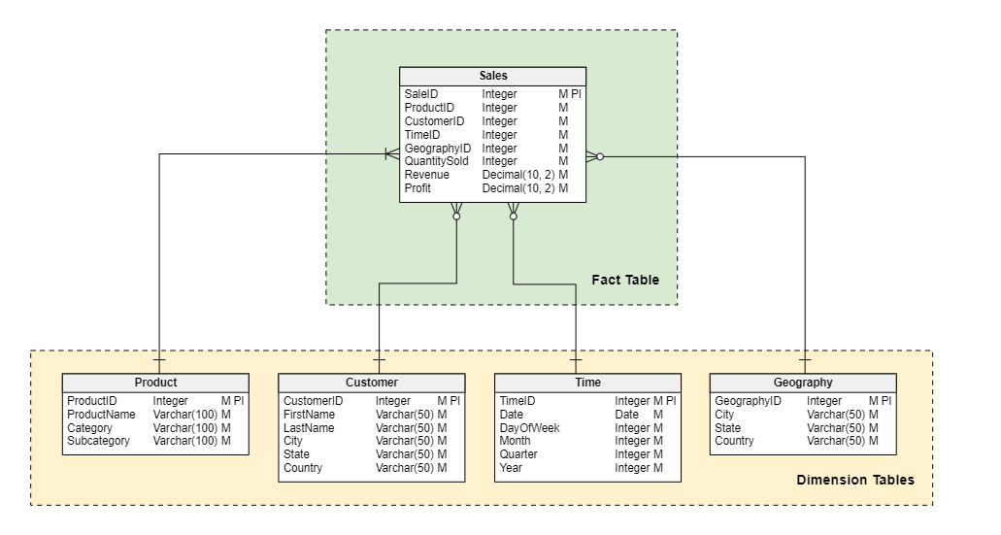
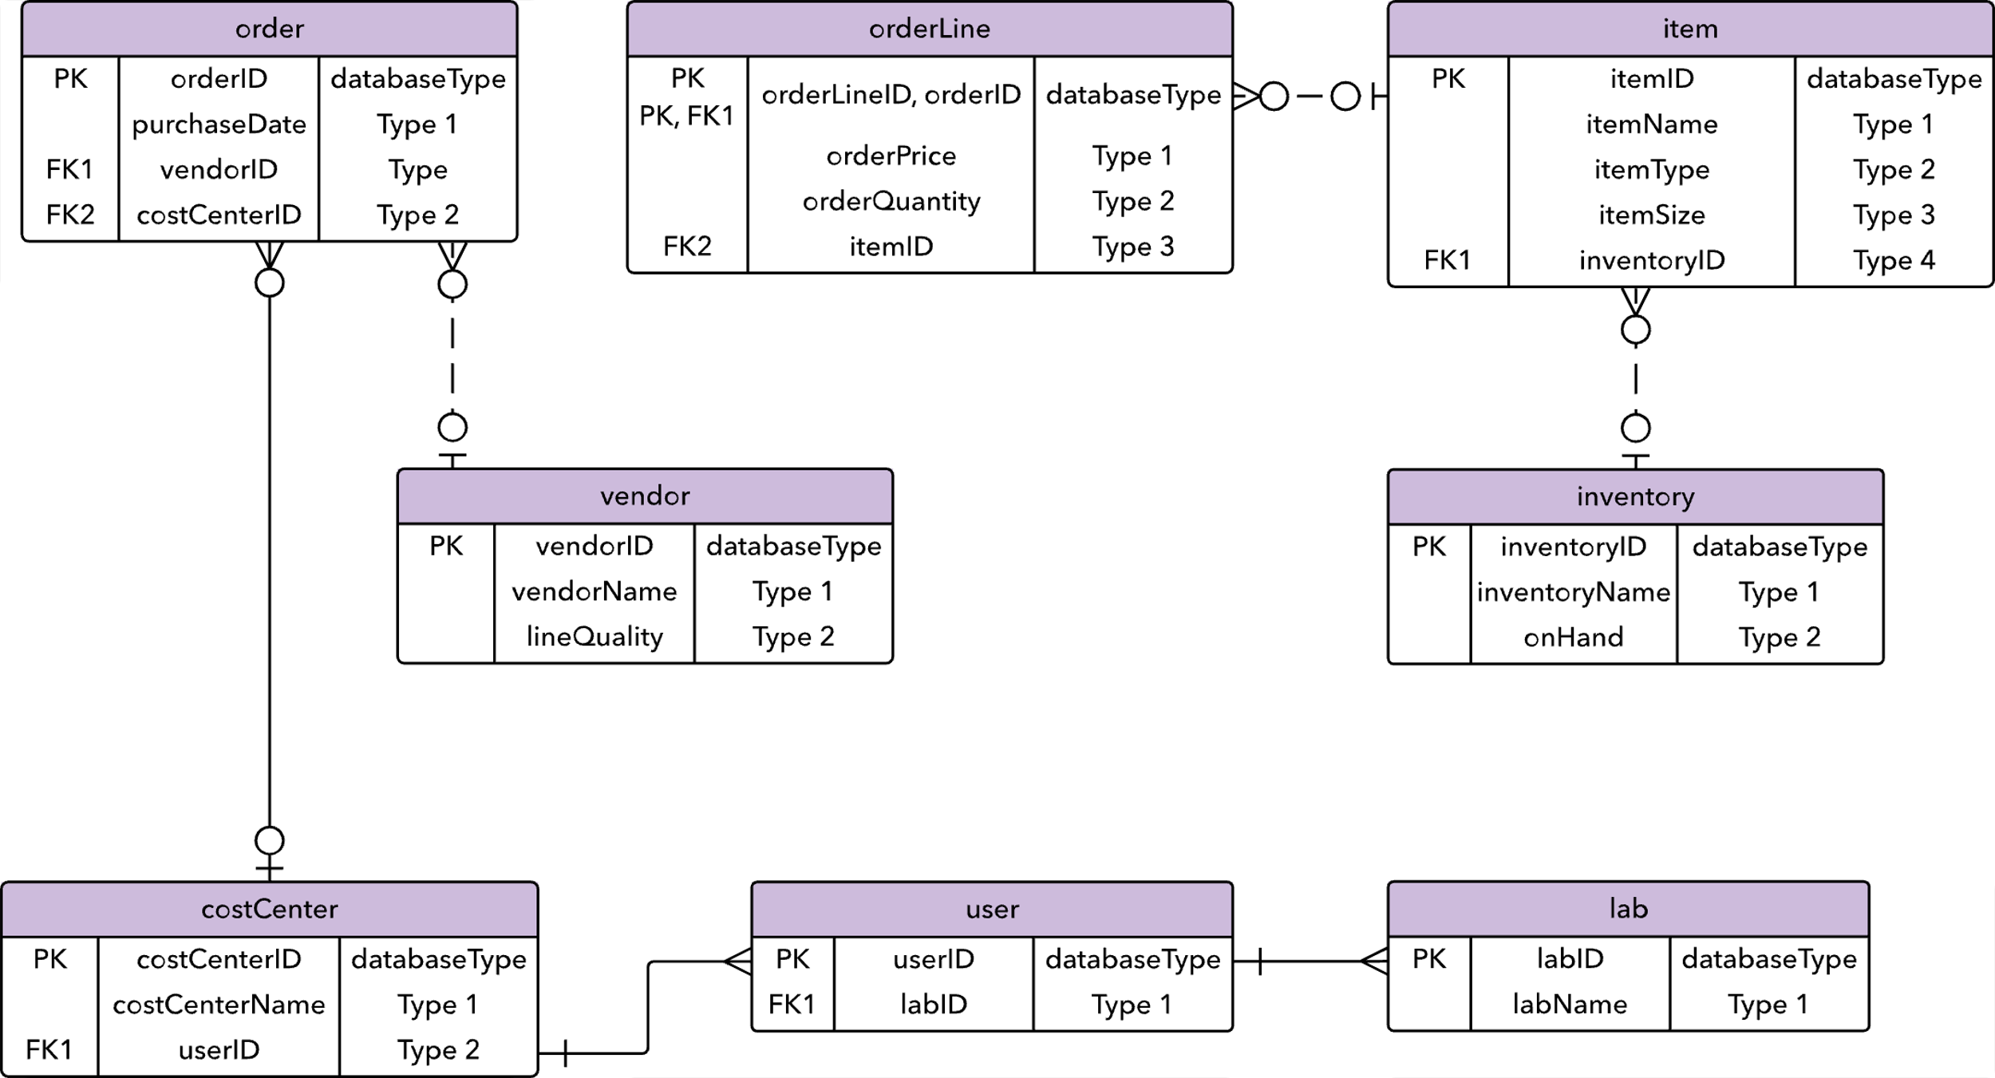
01
Database model
Fig: Example of STAR schema
Fig: Example of Entity-relationship model

Slide 6
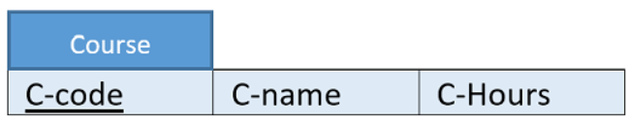
01
Relational model
The relational model was developed in 1970 by EF Codd as a way to model data in a table format, rather than as a diagram. Instead of focusing on the relationships and instances between entities, tables in the relational model show relevant data, how each table is related.
In other words, each ‘table’ stands for a relation schema in the relational model.
Example:
“Each course has a unique ID, Name and Accumulated Hours”.
relation
attributes
schema: Course (ID, name, hours)

Slide 7
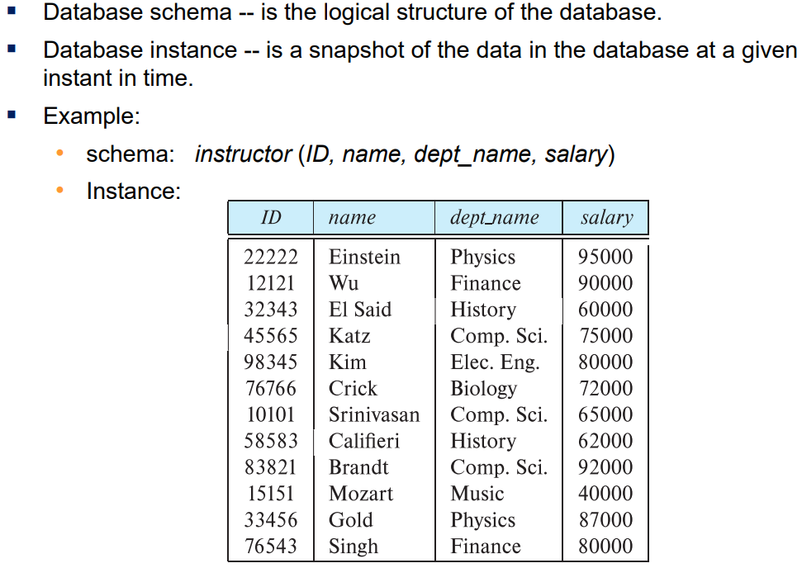
01
Schema & Instance
~class
~instance

Slide 8
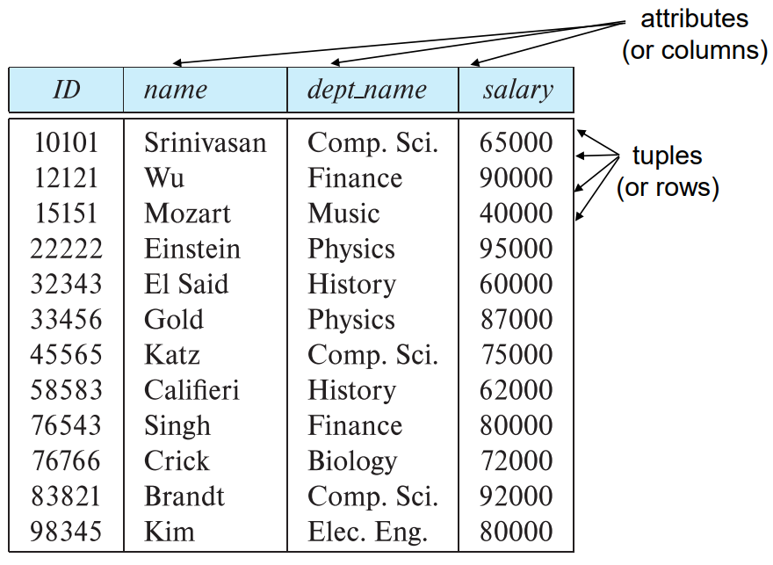
01
Important terminologies
Attributes: properties that define an entity (col).
Domain: The set of allowable values for each attribute.
Tuple: a single record in the database (row).

Slide 9

Keys

Slide 10
02
Introduction to keys
Q: What are ‘keys’?
A: A key is an attribute or a group of attributes in a table. Q: Why do we implement ‘keys’?
A1: Uniqueness. We have mentioned that each record is unique in the schema, which formalizes the notion of super key, primary key, and candidate key.
A2: Association. A simple way to associate with different schema is to copy one’s primary key into the other’s attribute, which is an image of the linked relation’s primary key.

Slide 11
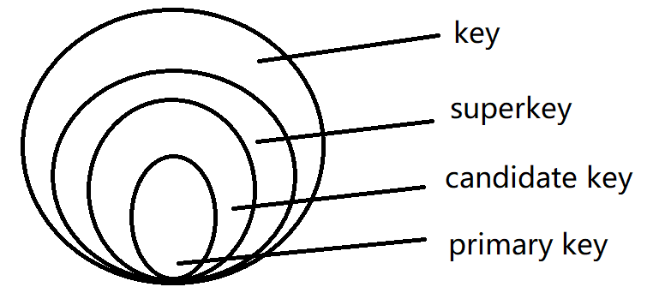
02
Super, candidate and primary keys
A super key is any set of attributes whose values, taken together, uniquely identify each row of a table.
A candidate key is a minimal super key.
A primary key is the specific candidate key that we picked to serve as the unique identifier for rows of this table.

Slide 12
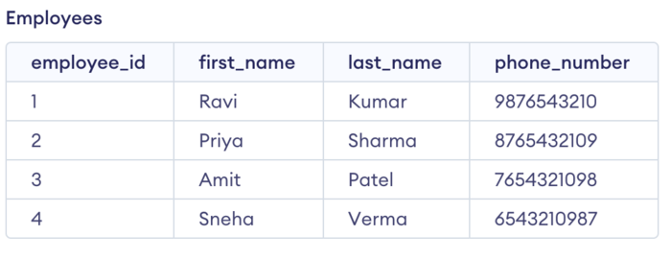
02
Practice 1
Q1: What are super keys?
Q2: What are candidate keys?
Q3: How many primary keys are possible?

Slide 13
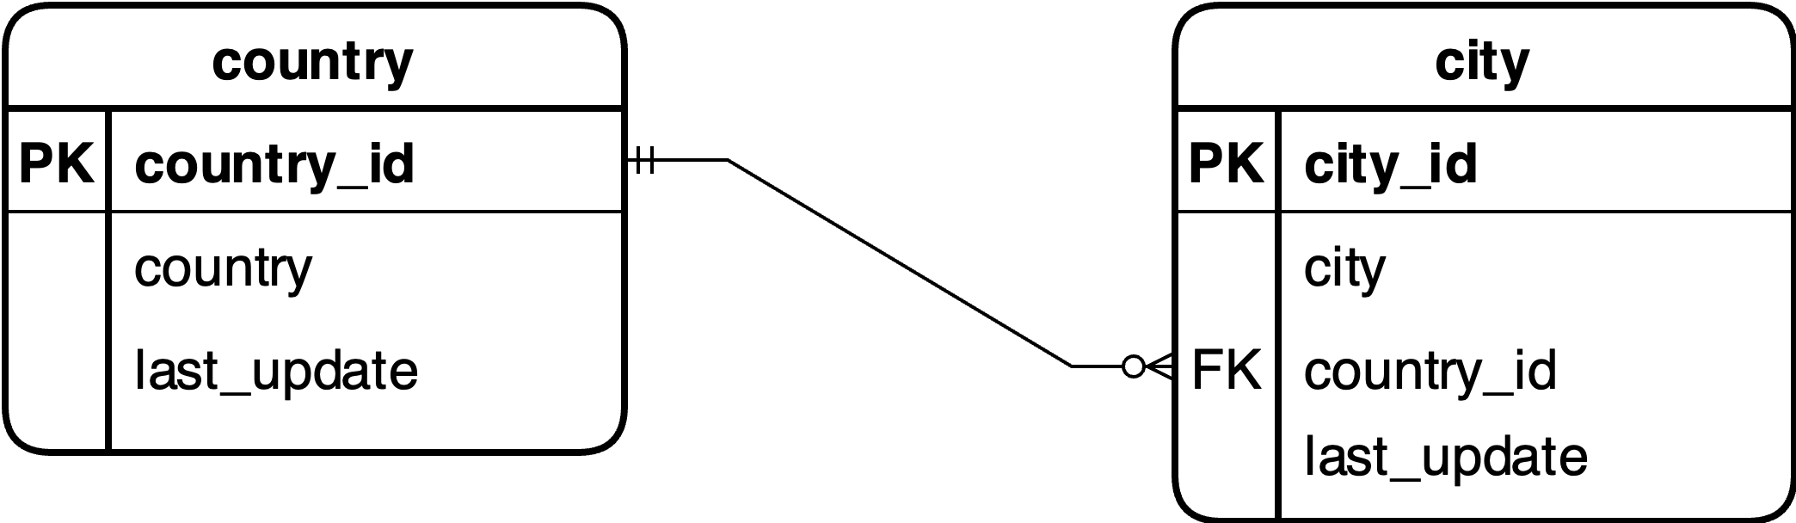
02
Foreign keys
A foreign key is a column or columns in a table that that are linked to a primary key in a different table.
primary key
foreign key

Slide 14

Relational Algebra

Slide 15
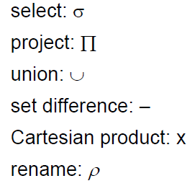
03
Relational Algebra
Relational algebra is a procedural query language, which takes instances of relations as input and yields instances of relations as output.
There are 6 basic operators:

Slide 16
03
Practice 2
Consider a database with the following schema:
Person ( name, age, gender )
Frequents ( name, pizzeria ) [Note: visit a lot]
Eats ( name, pizza )
Serves ( pizzeria, pizza, price )
Write relational algebra expressions for the following 4 queries:
Find all pizzerias frequented by at least one person under the age of 18.
Find the names of all females who eat either mushroom or pepperoni pizza (or both).
Find the names of all females who eat both mushroom and pepperoni pizza.
Find all pizzerias that serve at least one pizza that Amy eats for less than $10.00.

Slide 17
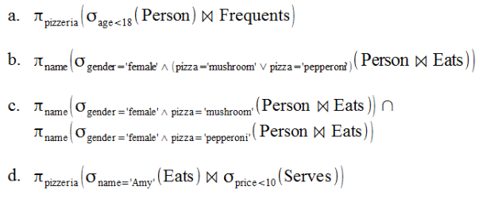
03
Practice 2 keys
For more practice questions, you may visit: Relational Algebra Exercises

Slide 18
Thank you!

